Slide 1
Hidden Markov Model Synthetic Generator for the UCRB – basic training and steps
Antonia Hadjimichael
Code by Julianne Quinn
March 2021

Slide 2
Hidden Markov Models - some basic info
A system switches between a fixed number of unobserved or ‘‘hidden’’ states via a Markov chain and corresponding transition probabilities.
Each state corresponds to a probability distribution, called a component distribution, from which observed time series values are drawn.
In applications to streamflow, HMM are attractive because of their ability to simulate long persistence and regime switching behavior in hydrologic time series.
Regime changes, or switches between hidden states, especially on the annual scale have been attributed to regime shifts driven by large-scale climate features.

Slide 3

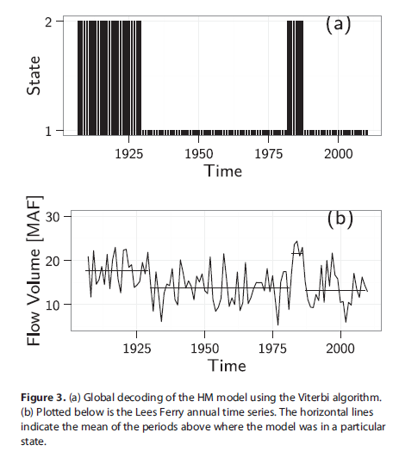
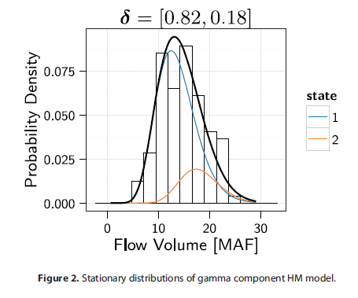
Model formulation

Slide 4
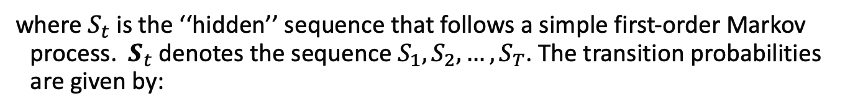
Model formulation
For an observed sequence $X_{t}, t=1,2,…,T$:
where $S_{t}$ is the ‘‘hidden’’ sequence that follows a simple first-order Markov process. $S_{t}$ denotes the sequence $S_{1},S_{2},…,S_{T}$. The transition probabilities are given by:
where m is the number of hidden states in the model

Slide 5
The rest of this training demonstrates the use of the Hidden Markov Model for the UCRB using streamflow data from StateMod

Slide 6
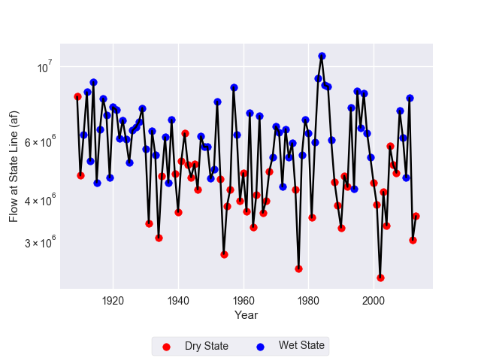
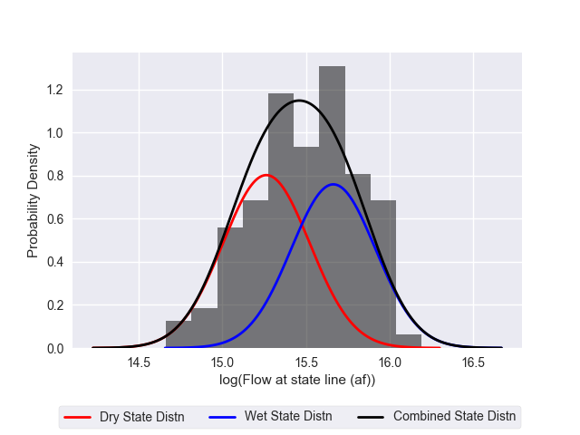
Gaussian HMM of log-space annual flows
Fit to log space annual flows at the last node, using the Expectation Maximization (EM) algorithm.
Generate time series of states and flows
 | Dry State | Wet State
Dry State | P00 = 0.68 | P01 = 0.32
Wet State | P10 = 0.35 | P11 = 0.65
Annual streamflow exhibits persistence

Slide 7
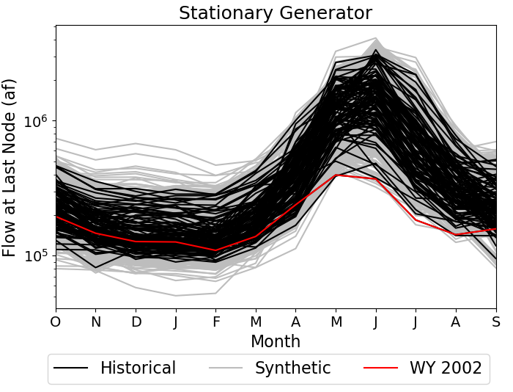
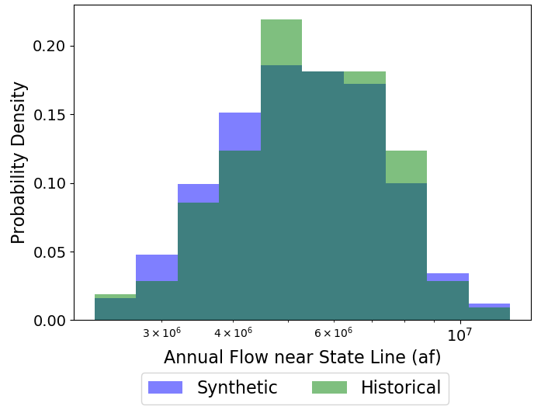
Stationary Synthetic Generator

Slide 8
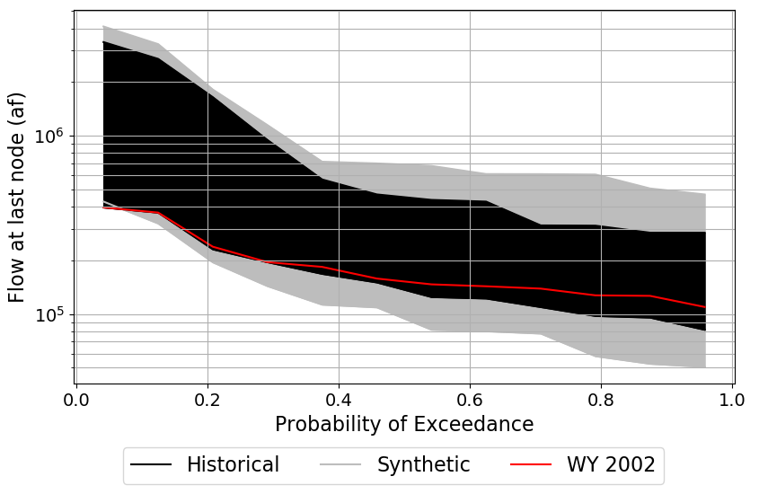
Stationary Synthetic Generator

Slide 9
Hydrologic Model - Synthetic Generator
Mimicking change in the timing of snowmelt
Model an n-day shift in the timing of snowmelt by shifting daily flows by n days and recomputing monthly means
Time before annual peak

Slide 10
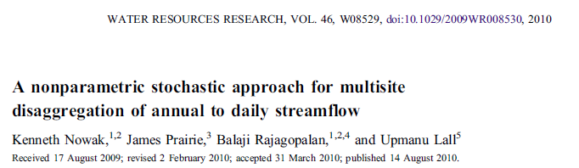
Disaggregation to monthly values
Probabilistically select one of k nearest neighbors based on Euclidean distance of total annual flows across sites between generated year and all historical years. Proportionally scale all monthly flows and demands from selected year to match synthetic totals at the last node.

Slide 11
Disaggregation to upstream nodes
Using the monthly streamflow values at the last node, the monthly values at all other nodes are computed by using the ratio of month i's flow at node j to month i's flow at the last node in the historical year that was used for the monthly disaggregation at the last node.

Slide 12
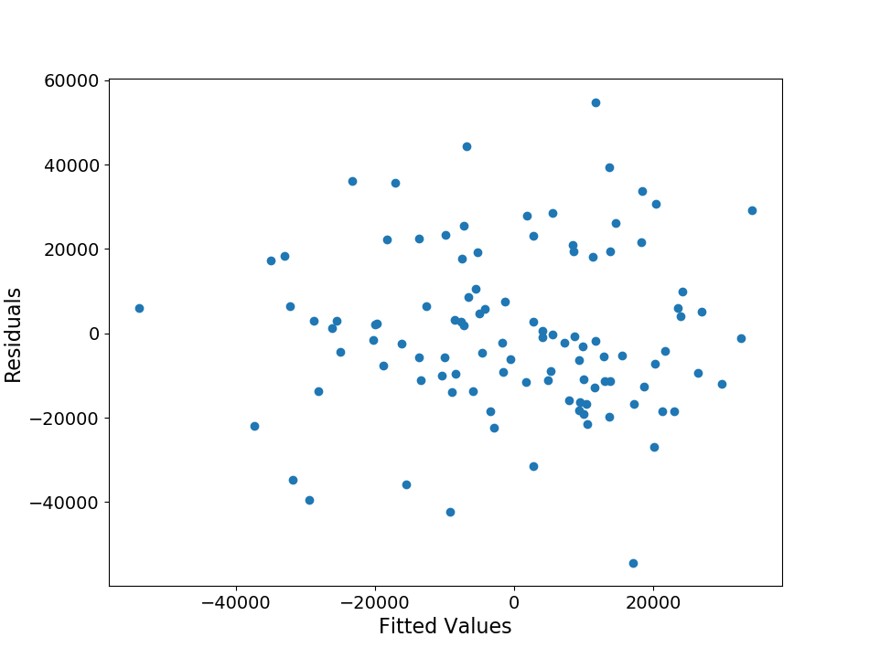
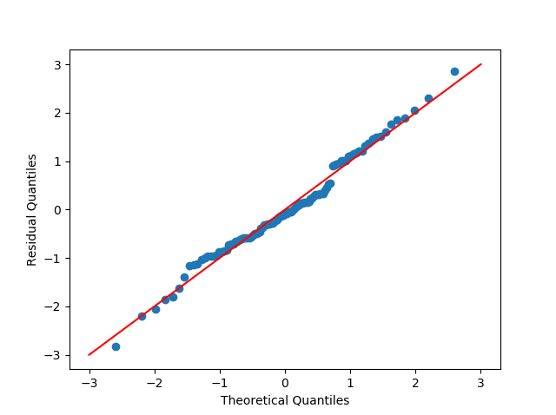
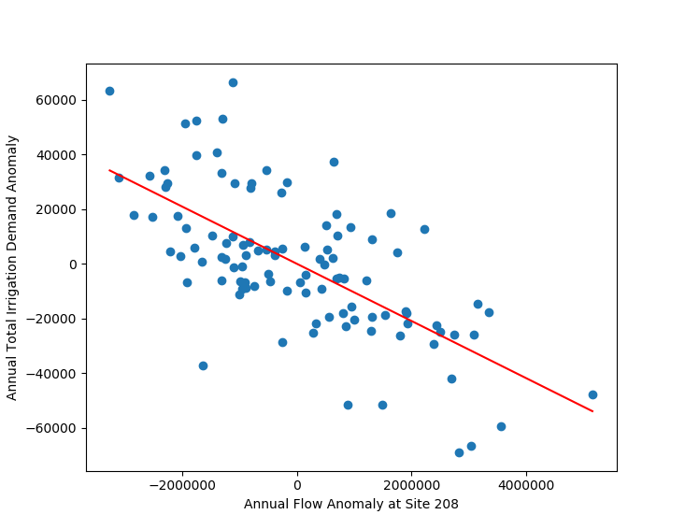
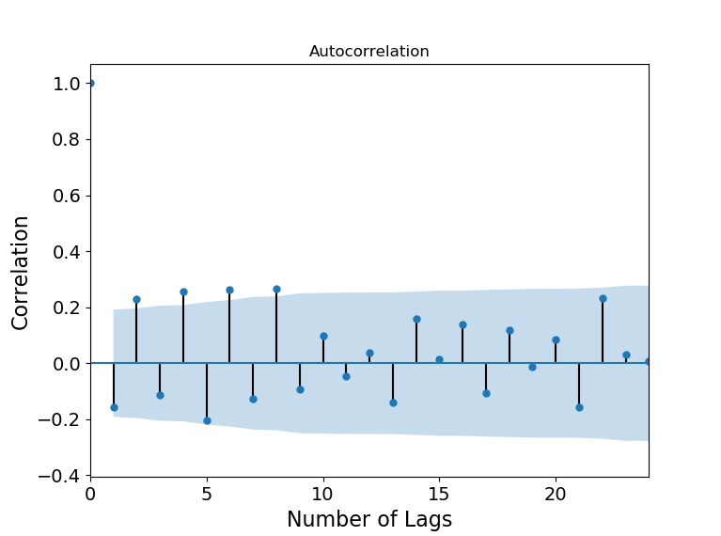
Hydrologic Model – Irrigation Demands
Apply irrigation demand multiplier to historical mean demand and add annual anomaly, conditional on annual streamflow at last node + Gaussian noise
Residuals are:
Homoskedastic
Uncorrelated
Normally Distributed

Slide 13
So what parameters can we change in our model?
Uncertainty | Min | Max | File Edited
μ₀ Multiplier (Log-space mean of dry state) | 0.95 | 1.05 | .xbm
σ₀ Multiplier (Log-space std of dry state) | 0.5 | 1.5 | .xbm
μ₁ Multiplier (Log-space mean of wet state) | 0.95 | 1.05 | .xbm
σ₁ Multiplier (Log space std of wet state) | 0.5 | 1.5 | .xbm
p₀₀ delta shift (dry-dry transition probability) | -0.3 | +0.3 | .xbm
p₁₁ delta shift (wet-wet transition probability) | -0.3 | +0.3 | .xbm
Evaporation Delta Shift | -0.5 in/month | +1.0 in/month | .eva
How do these parameter changes affect flows?

Slide 14
Hydrologic Uncertainties
Effects of changes in mixed Gaussian hidden Markov model
μ₀
μ₁
σ₀
σ₁
 | Dry State | Wet State
Dry State | p₀₀ = 0.68 | p₀₁ = 0.32
Wet State | p₁₀ = 0.35 | p₁₁ = 0.65
Annual streamflow exhibits persistence

Slide 15
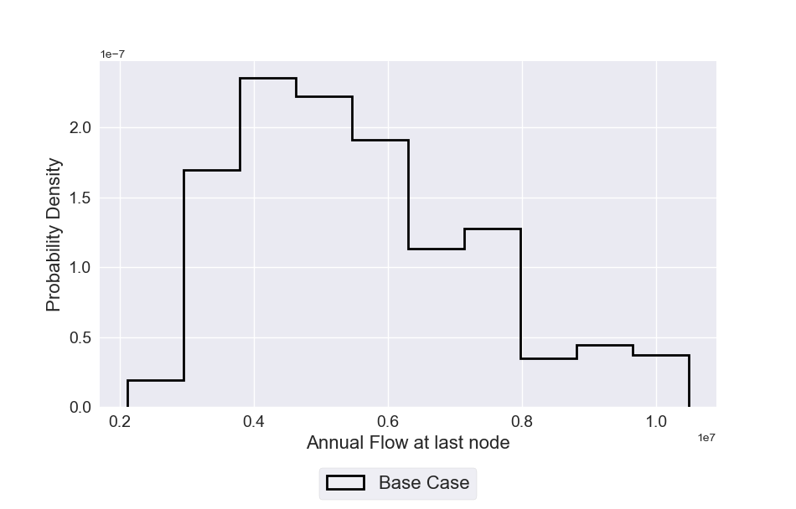
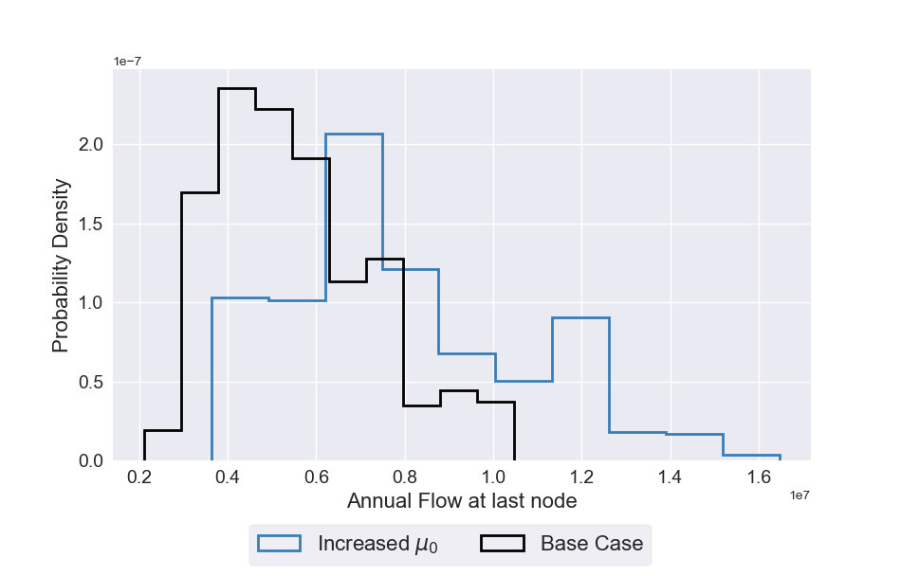
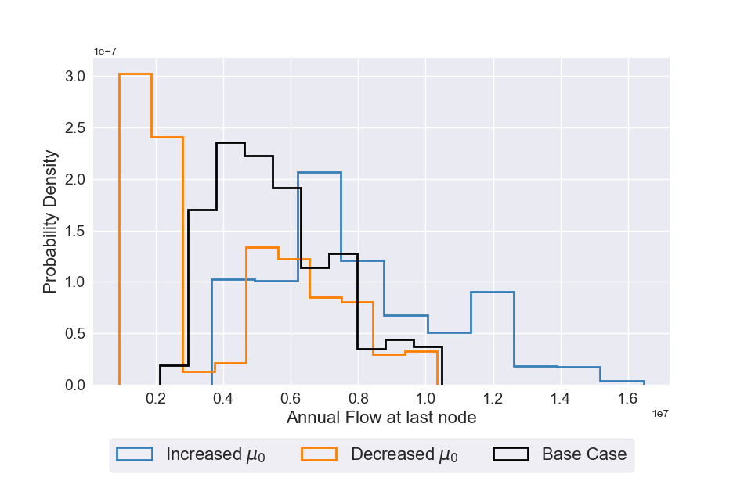
Hydrologic Uncertainties
Effects of changes in μ₀
μ₀
 | Dry State | Wet State
Dry State | p₀₀ = 0.68 | p₀₁ = 0.32
Wet State | p₁₀ = 0.35 | p₁₁ = 0.65
Decreased μ₀: Lower lower tail
Increased μ₀: Higher upper tail

Slide 16
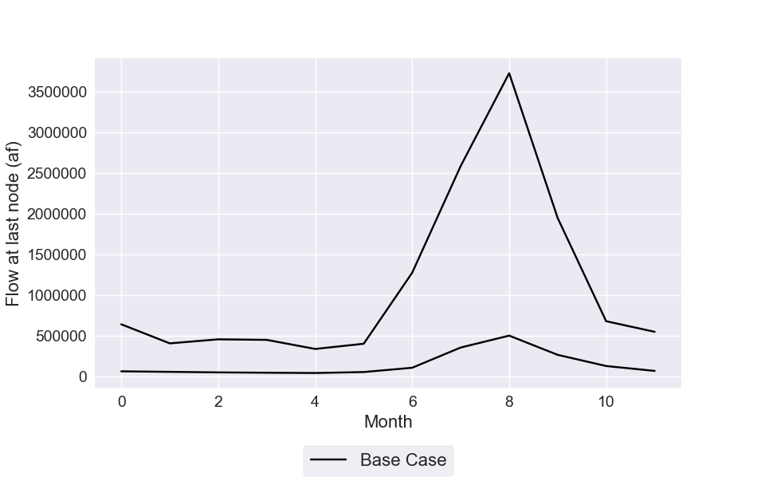
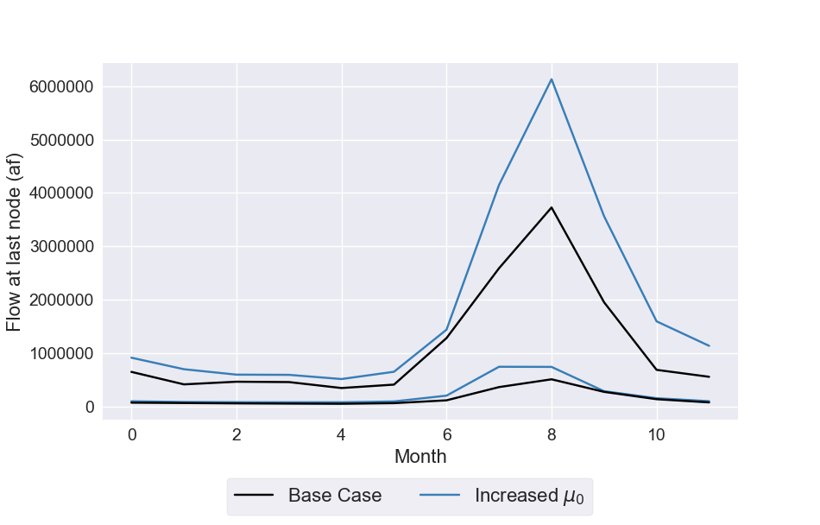
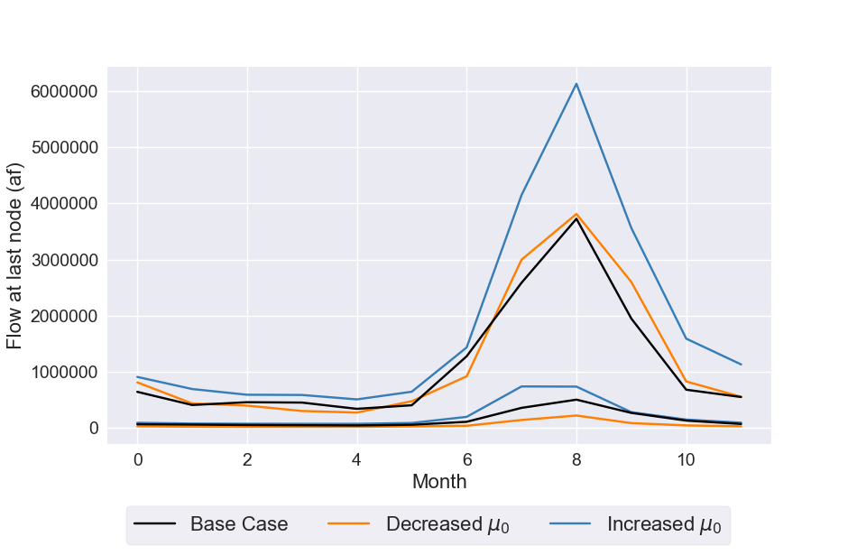
Hydrologic Uncertainties
Effects of changes in μ₀
Max monthly flow over 1000 synthetic years
μ₀
Min monthly flow over 1000 synthetic years
 | Dry State | Wet State
Dry State | p₀₀ = 0.68 | p₀₁ = 0.32
Wet State | p₁₀ = 0.35 | p₁₁ = 0.65

Slide 17
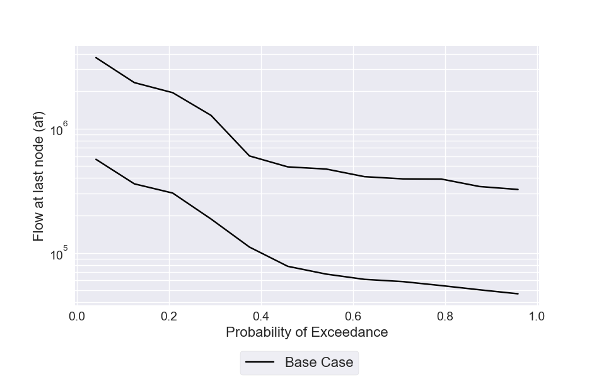
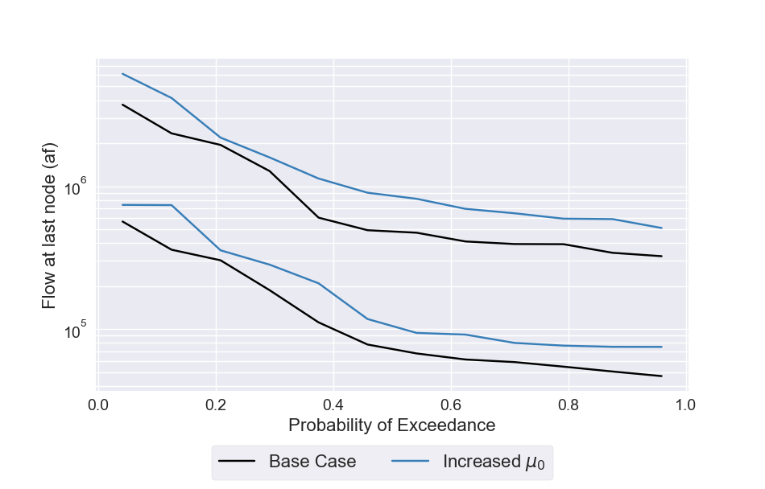
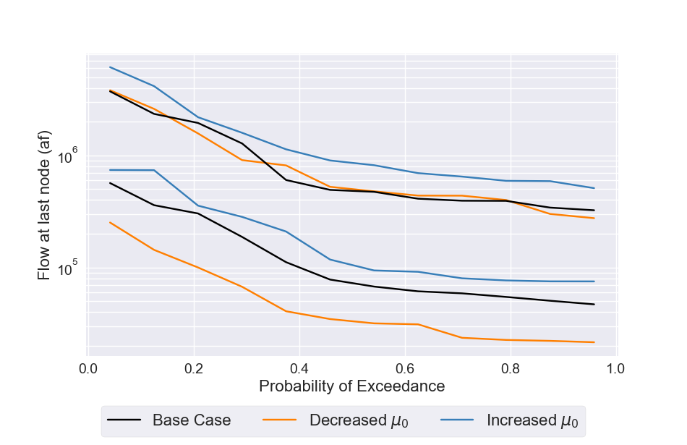
Hydrologic Uncertainties
Effects of changes in μ₀
Max monthly flow over 1000 synthetic years
μ₀
Min monthly flow over 1000 synthetic years
 | Dry State | Wet State
Dry State | p₀₀ = 0.68 | p₀₁ = 0.32
Wet State | p₁₀ = 0.35 | p₁₁ = 0.65
Decreased μ₀: Lower lower tail
Increased μ₀: Higher upper tail

Slide 18
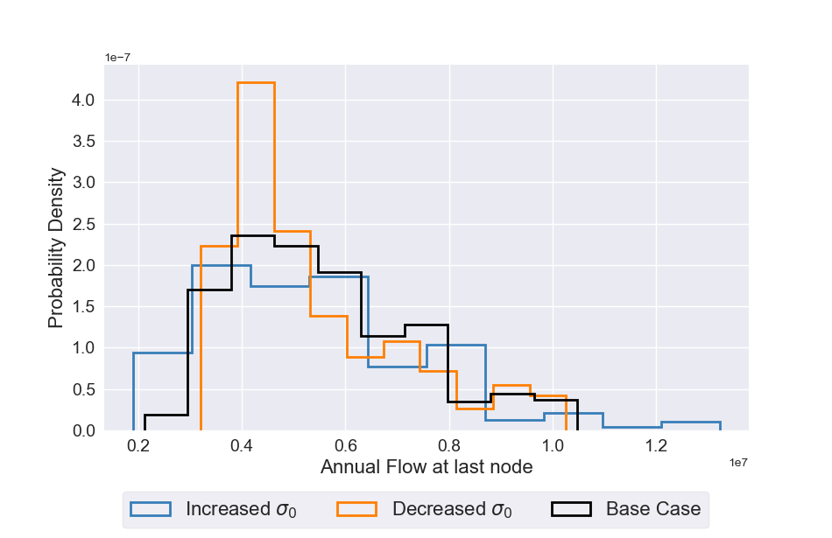
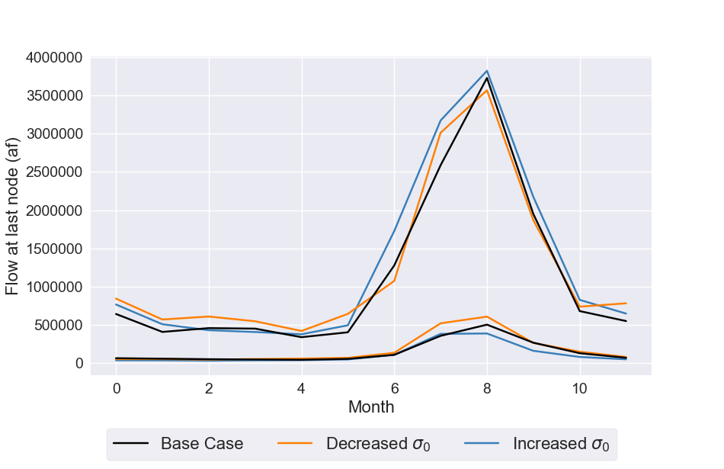
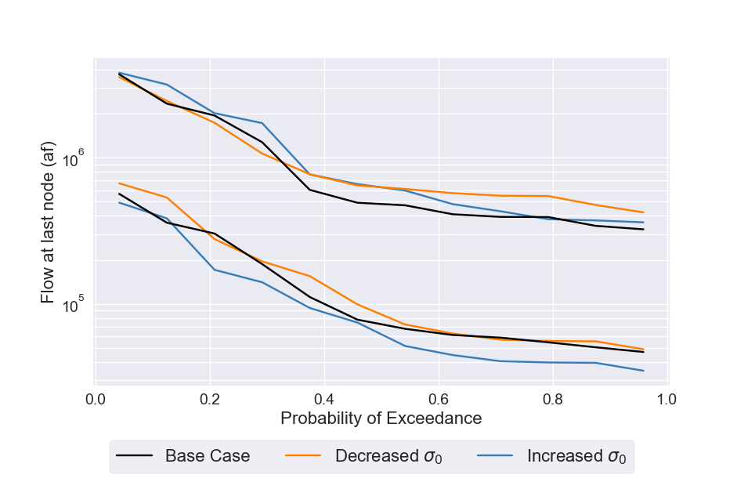
Hydrologic Uncertainties
Effects of changes in σ₀
σ₀
 | Dry State | Wet State
Dry State | p₀₀ = 0.68 | p₀₁ = 0.32
Wet State | p₁₀ = 0.35 | p₁₁ = 0.65
Decreased σ₀: Higher lower tail
Increased σ₀: Higher upper tail
Little change to hydrograph

Slide 19
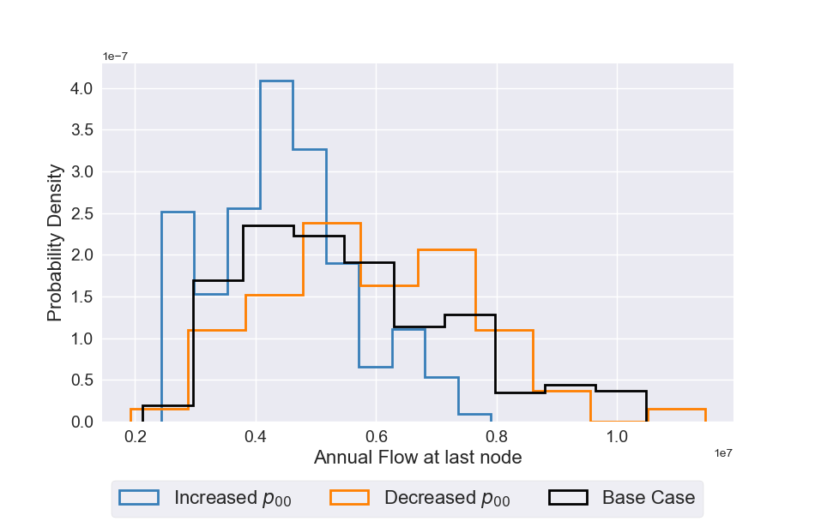
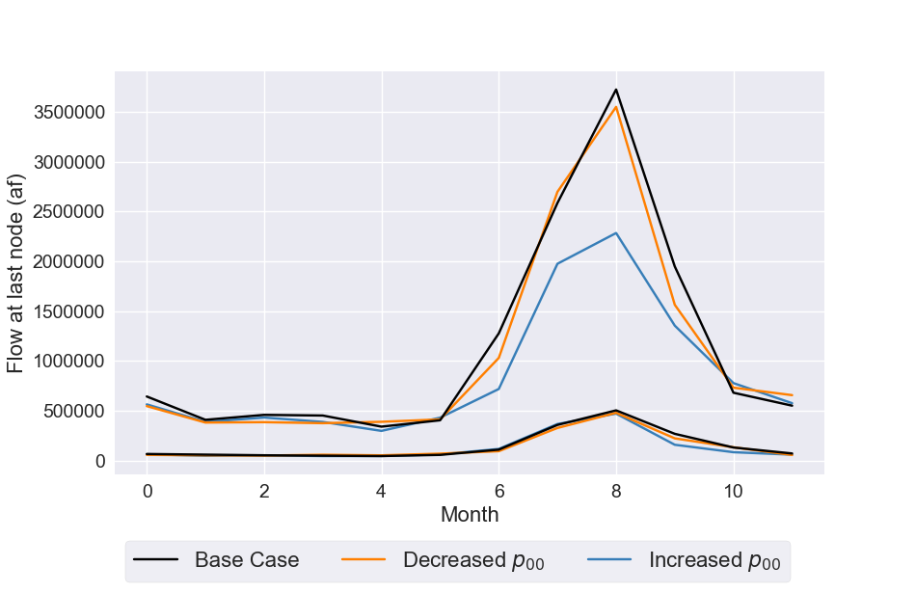
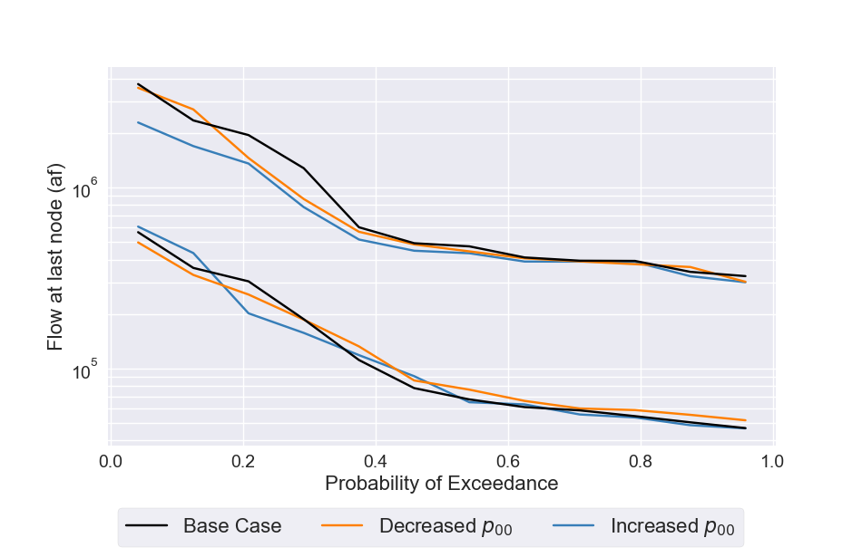
Hydrologic Uncertainties
Effects of changes in p₀₀
 | Dry State | Wet State
Dry State | p₀₀ = 0.68 | p₀₁ = 0.32
Wet State | p₁₀ = 0.35 | p₁₁ = 0.65
Decreased μ₀: Higher probability of wet years
Increased p₀₀: Higher probability of dry years
Lower peak flows

Slide 20
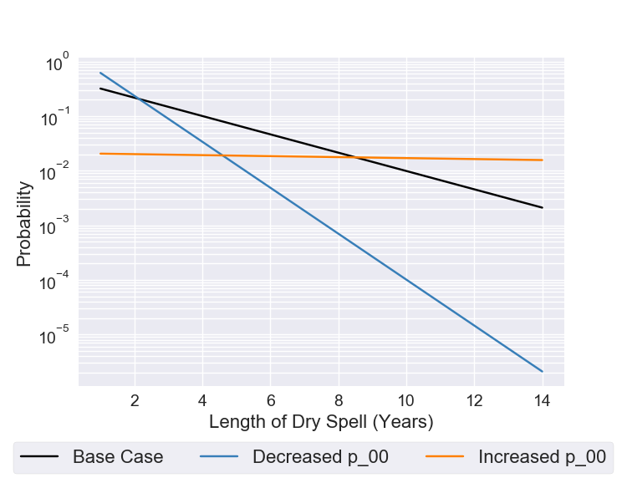
Hydrologic Uncertainties
Effects of changes in p₀₀
Increased p₀₀: Lower probability of short and moderate drought, higher probability of very long droughts
 | Dry State | Wet State
Dry State | p₀₀ = 0.68 | p₀₁ = 0.32
Wet State | p₁₀ = 0.35 | p₁₁ = 0.65

Slide 21
The following demonstration shows how to synthetically generate the flows used by these papers:
Hadjimichael et al., “Advancing Diagnostic Model Evaluation to Better Understand Water Shortage Mechanisms in Institutionally Complex River Basins,” Water Resources Research, doi: 10.1029/2020WR028079.
Hadjimichael et al., “Defining Robustness, Vulnerabilities, and Consequential Scenarios for Diverse Stakeholder Interests in Institutionally Complex River Basins,” Earth’s Future, doi: 10.1029/2020EF001503.
An adapted version of these scripts is used to generate flows for this paper:
Quinn et al. “Can exploratory modeling of water scarcity vulnerabilities and robustness be scenario neutral?,” Earth’s Future, doi: 10.1029/2020EF001650.
and can be found here: https://github.com/julianneq/UCRB_analysis

Slide 22
Python packages needed
hmmlearn
seaborn
scipy
pandas
mpi4py

Slide 23
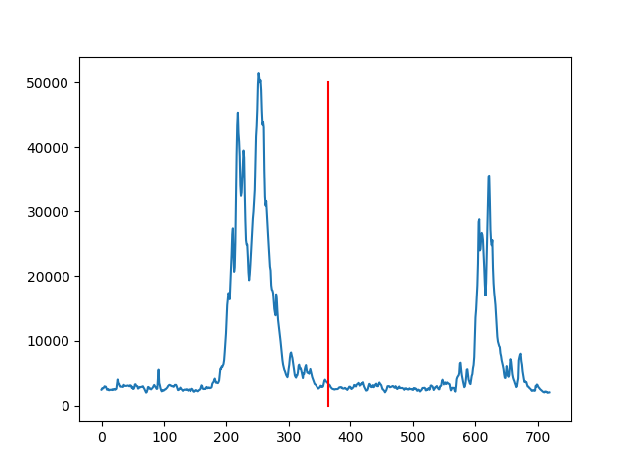
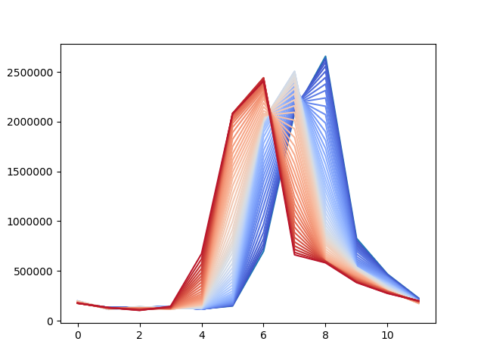
First, some complications on mimicking change in the timing of snowmelt
Last node in network is USGS gage.
Simple idea: To model an n-day shift in the timing of snowmelt (from 0->60 days earlier), shift daily flows at this gage by n days and re-compute monthly means.
60-day shift
Daily flows
Monthly flows
60-day shift
Base year

Slide 24
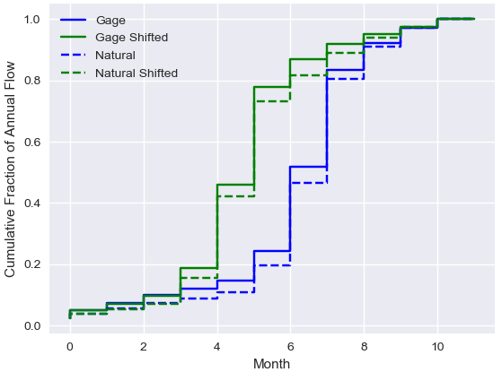
First, some complications on mimicking change in the timing of snowmelt
Complication 1: Monthly flows at this node in the model are natural flows, so they do not perfectly match the monthly flows at the gage
Solution: Apply same CDF shift to natural flows as CDF shift in gage flows

Slide 25
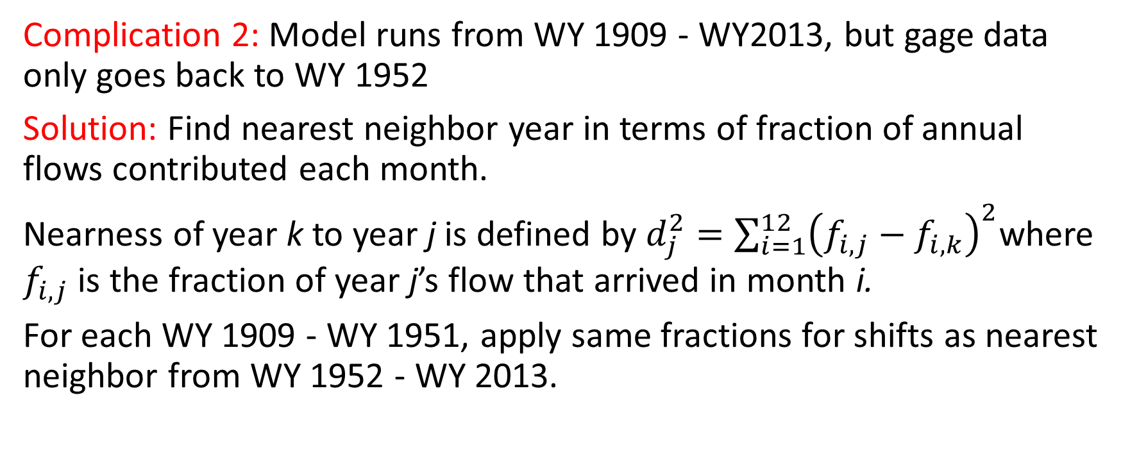
First, some complications on mimicking change in the timing of snowmelt
Complication 2: Model runs from WY 1909 - WY2013, but gage data only goes back to WY 1952
Solution: Find nearest neighbor year in terms of fraction of annual flows contributed each month.
Nearness of year k to year j is defined by $d_{j}^{2}=\sum_{i=1}^{12}{{\left(f_{i,j}−f_{i,k}\right)}^{2}}$where $f_{i,j}$ is the fraction of year j’s flow that arrived in month i.
For each WY 1909 - WY 1951, apply same fractions for shifts as nearest neighbor from WY 1952 - WY 2013.

Slide 26
1. Sample generator scaling parameters (and other parameters)
Script:
https://github.com/antonia-had/UCRB_analysis/blob/master/Qgen/sample_parameters.sh
Input files:
uncertain_params_original.txt (contains ranges of each parameter)
Output files:
LHsamples_original_1000.txt (LHS of all parameters)
Other requirements: MOEAFramework-2.4-Demo.jar

Slide 27
Streamflow generation process
For last node in gage, re-compute monthly totals with shifts of n = 1-60 days.
Apply same monthly CDF shifts from step i to CDF of monthly naturalized flows (used by the model).
For 1909-1951, apply same CDF shifts of nearest neighbor from 1952-2013.
Step 2: timeShiftModel.py (preprocessing)
When generating synthetic flows, a random historical year is chosen to downscale the annual flow at the last node (208) to monthly flows. Use the monthly fractions of the selected historical year with the time shift computed in 1-3 above to temporally downscale the flow at the last node in the synthetic year.
Determine the monthly flows at all upstream nodes k by using the same ratio Q_{i,k}/Q_{i,208} for month i from the historical year chosen for downscaling in step i.
Step 5: generateQs_spatialDisaggregation.py (actual generation)

Slide 28
2. Recompute monthly totals with snowmelt shift
Script:
https://github.com/antonia-had/UCRB_analysis/blob/master/Qgen/timeShiftModel.py
Input files:
cm2015x.xbm (StateMod input file containing naturalized streamflows for baseline dataset)
CO_River_UT_State_line.csv (Daily gaged streamflow at last node)
Outputs:
LastNodeFractions.npy

Slide 29
3. Extract monthly and annual flows from StateMod baseline data set
Script:
https://github.com/antonia-had/UCRB_analysis/blob/master/Qgen/reformatQdata.py
Input files:
cm2015x.xbm (StateMod input file containing streamflows for baseline dataset)
Outputs:
AnnualQ.csv (contains annual flows for 208 sites for 105 years)
MonthlyQ.csv (contains monthly flows for 208 sites for 105 years)

Slide 30
4. Extract monthly and annual irrigation demands from StateMod baseline data set
Script:
https://github.com/antonia-had/UCRB_analysis/blob/master/Qgen/reformatIWRdata.py
Input files:
cm2015B.iwr (StateMod input file containing irrigation demands for baseline dataset)
Outputs:
AnnualIWR.csv (contains annual demands for 208 sites for 105 years)
MonthlyIWR.csv (contains monthly demands for 208 sites for 105 years)

Slide 31
5. Fit Hidden Markov Model on historic annual flows and generate new ones
Script:
https://github.com/antonia-had/UCRB_analysis/blob/master/Qgen/generateQs_spatialDisaggregation.py
Input files:
AnnualQ.csv (contains annual flows for 208 sites for 105 years)
MonthlyQ.csv (contains monthly flows for 208 sites for 105 years)
LHsamples_original_1000.txt
cm2015x.xbm (StateMod input file containing streamflows for baseline dataset)
LastNodeFractions.npy
Outputs:
All HMM parameters for all sites (in .txt files)
New .xbm and .iwr files

Slide 32
Optional: Fit Hidden Markov Model on historic annual flows (to test the model etc.)
Script:
https://github.com/antonia-had/UCRB_analysis/blob/master/Qgen/fitHMM.py
Input files:
AnnualQ.csv (contains annual flows for 208 sites for 105 years)
Outputs:
MixedGaussianFit.png, StateTseries_Log.png

